Slide 1


Large Language Model (LLM) for Networking: an Overview
IETF 119 @ Brisbane
Xiaohui Xie
Tsinghua University, China
xiexiaohui@tsinghua.edu.cn

Slide 2
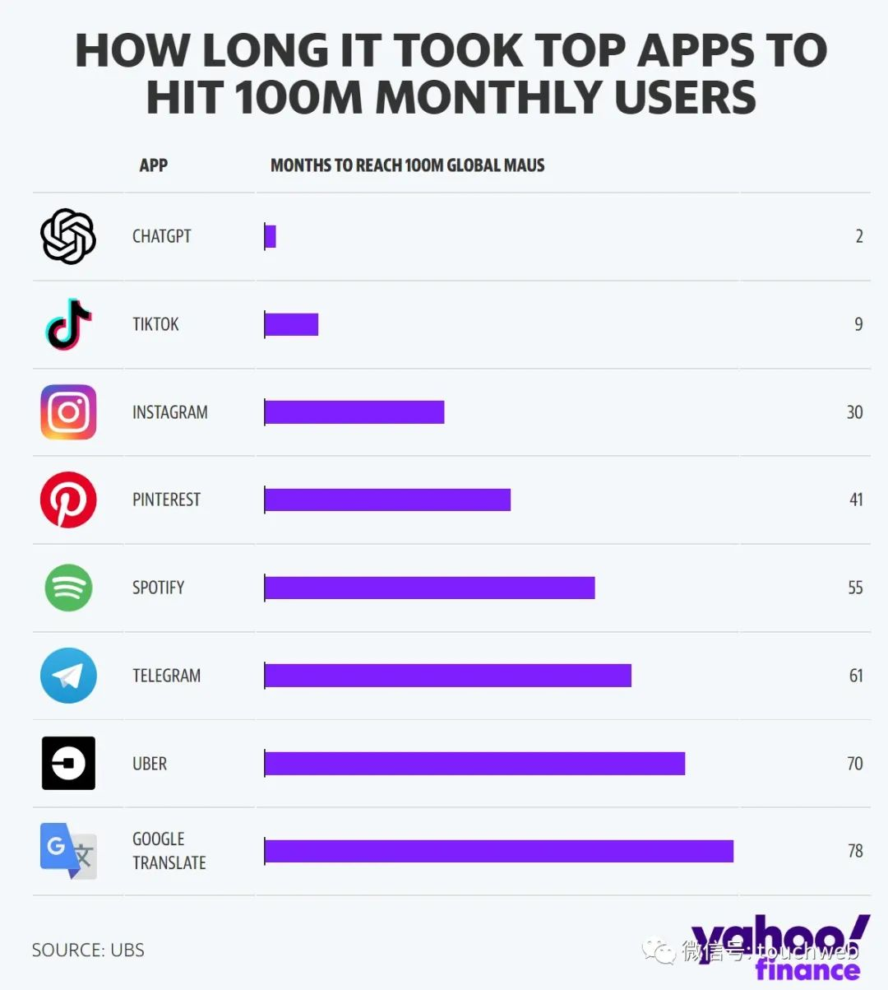
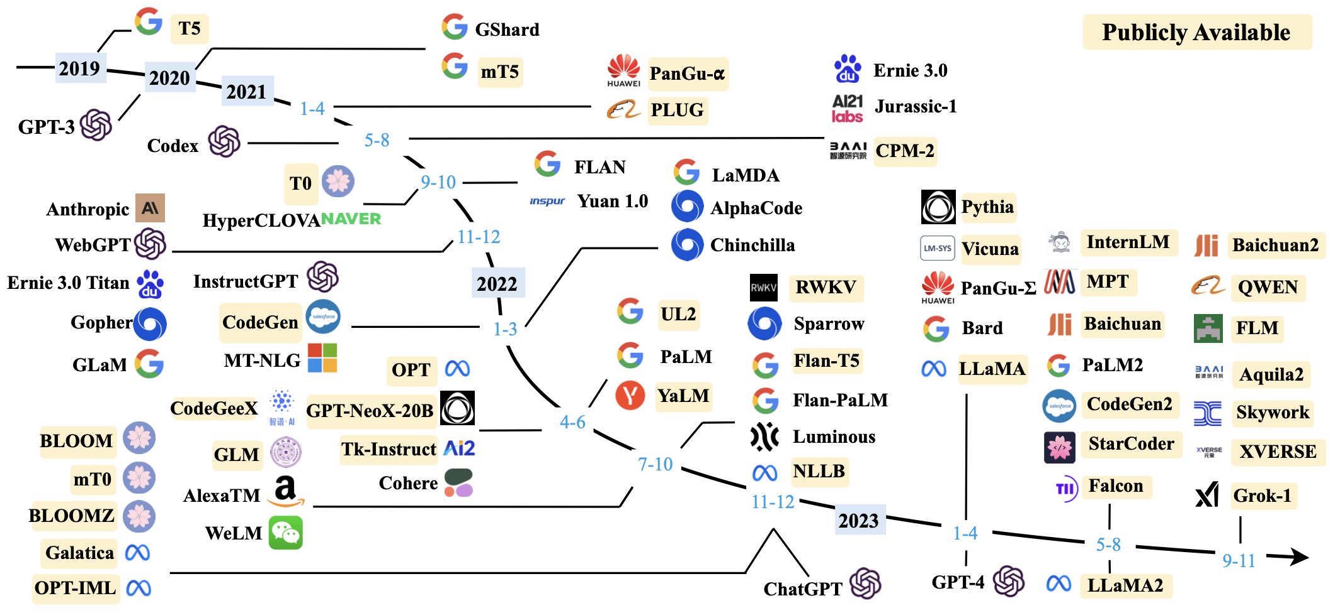
Background
The emergence of ChatGPT has marked the beginning of a rapid development era for the large language model (LLM) and the generative AI
[1] finance.yahoo. ChatGPT on track to surpass 100 million users faster than TikTok or Instagram
[2] Wayne Xin Zhao et al. A Survey of Large Language Models. Arxiv 2023

Slide 3
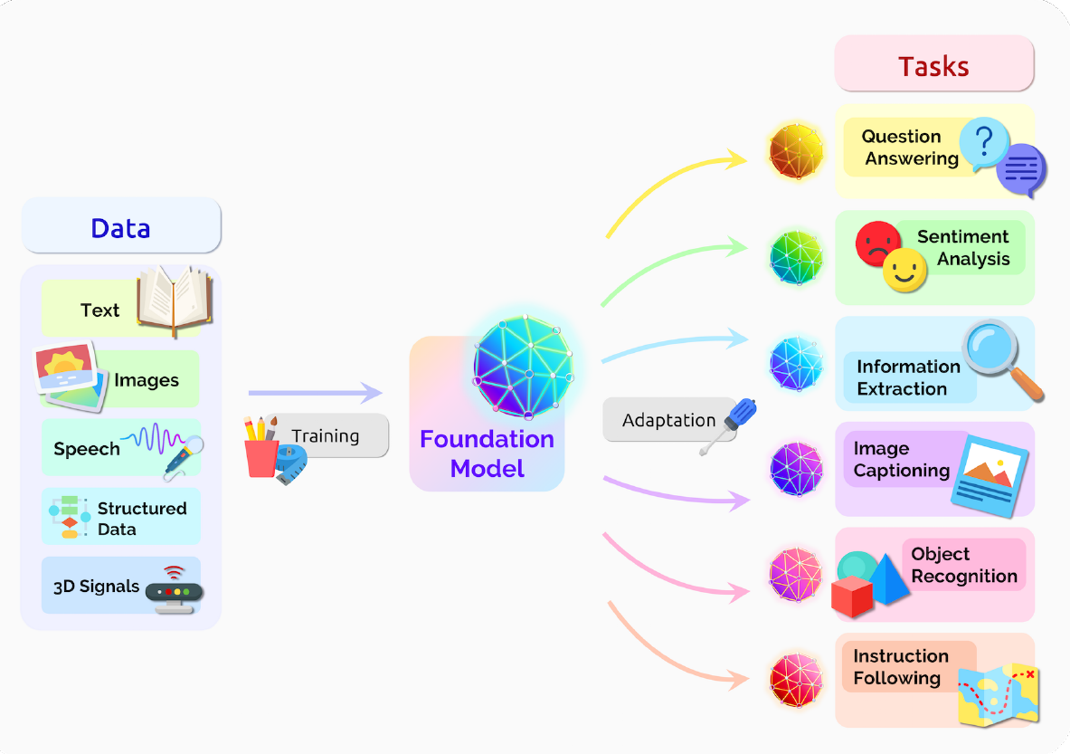

Background
LLMs show remarkable capabilities in concept understanding, mathematical reasoning, physical principle (maybe, see Sora) and tool usage
Prompt: A stylish woman walks down a Tokyo street filled with warm glowing neon and animated city signage. She wears a black leather jacket…
[1] https://openai.com/sora

Slide 4
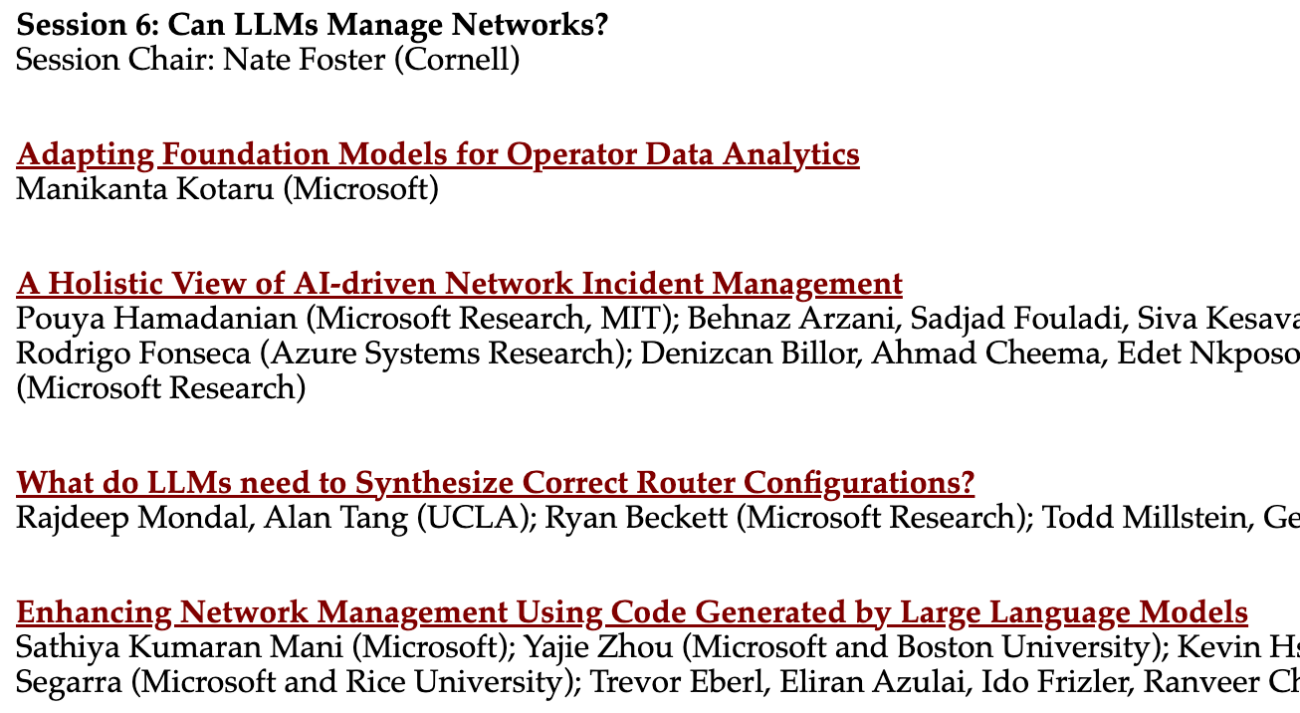
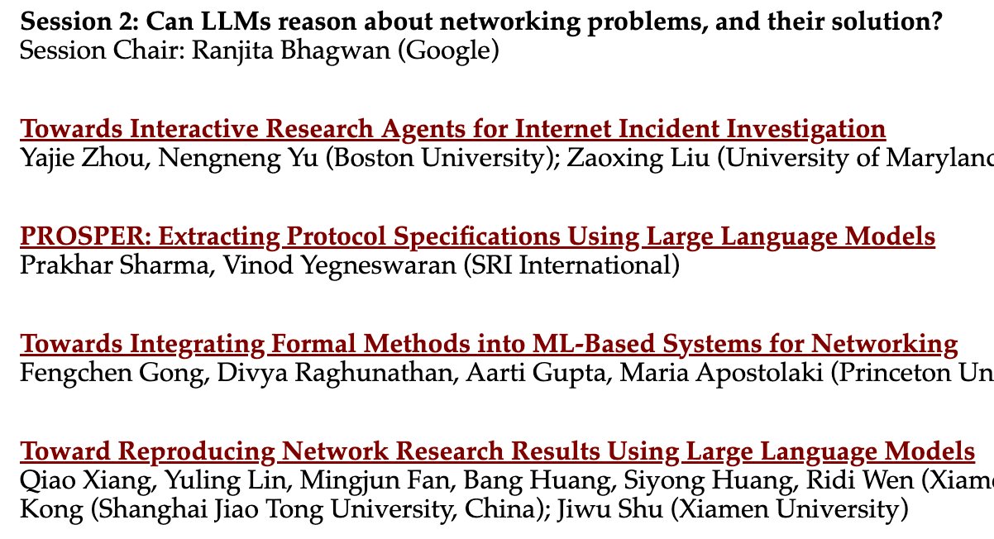
Background
The application of LLMs in the networking field is receiving increasing attention
Related Sessions @ HotNets 2023
[1] https://conferences.sigcomm.org/hotnets/2023/program.html

Slide 5
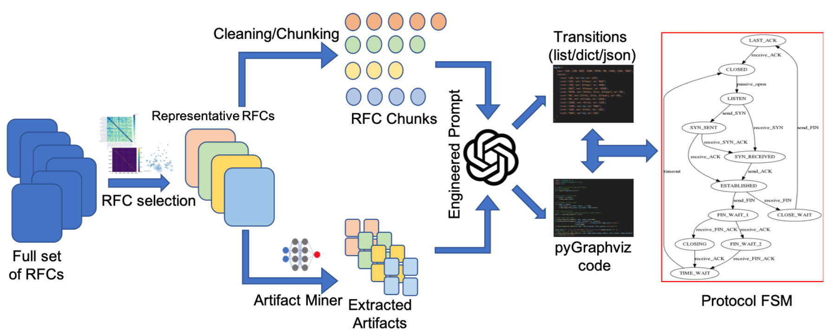
LLMs for Protocol Understanding
PROSPER uses LLMs to extract protocol FSM based on IETF RFCs
[1] Sharhama et al. PROSPER: Extracting Protocol Specifications Using Large Language Models. HotNets 2023

Slide 6
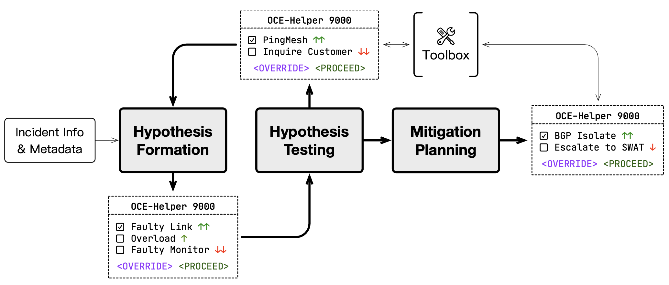
LLMs for Incident Management
LLM agents for On-Call Engineer (OCE) helper
[1] Hamadanian et al (MIT & Microsoft). A Holistic View of AI-driven Network Incident Management. HotNets 2023

Slide 7
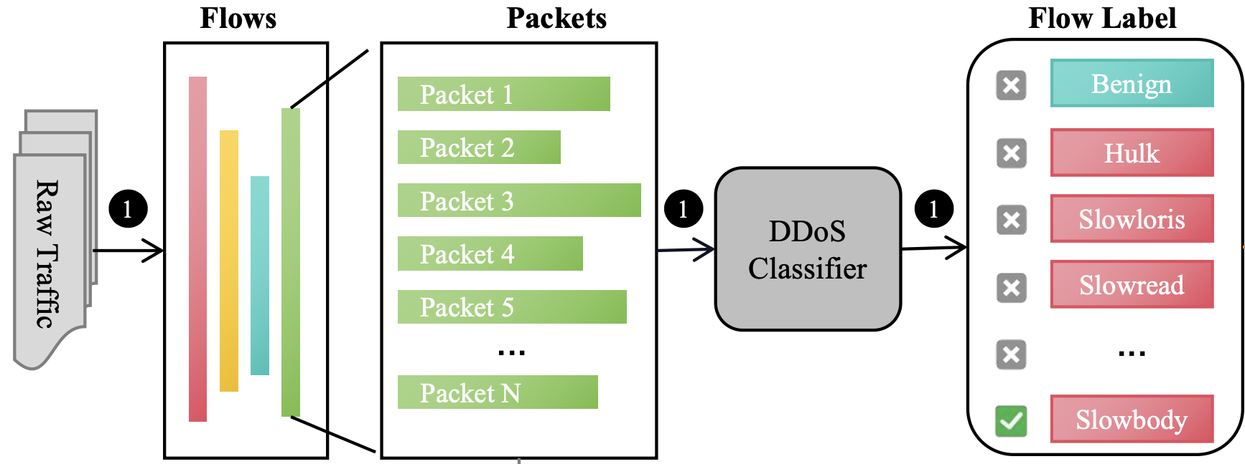
LLMs for Network Security
The constantly evolving Distributed Denial of Service (DDoS) attacks pose a significant threat to the cyber security
Existing AI-driven methods achieve impressive performance on DDoS detection, but two limitations hinder them from the more practical application
Lack of traffic-dependent explanations of detection results
Lack of actionable instructions for mitigation
AI-based
Classifier
Any Mitigation Instruction?
A Black Box

Slide 8





ShieldGPT: An LLM-based Framework for DDoS Mitigation
ShieldGPT is used for explanation and mitigation
Raw Traffic
AI-based
Classifier
Attack tags
Traffic
Representation
Attack
Explanation
Role
Representation
Mitigation
Strategies
Attack Descriptions

Slide 9
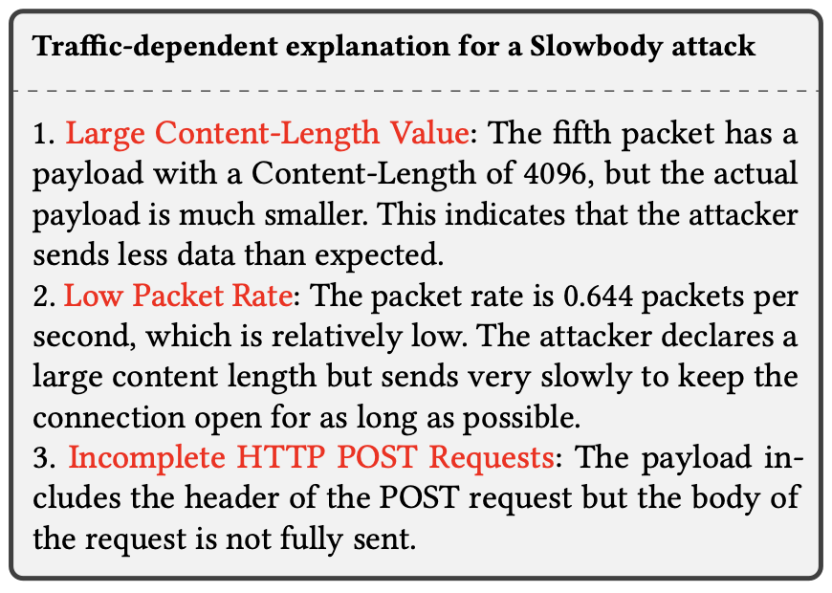
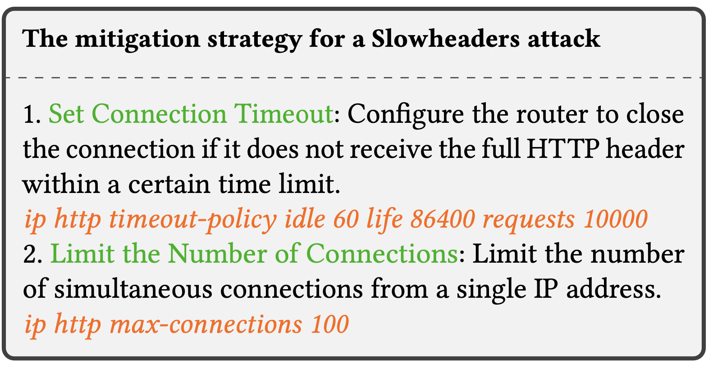
ShieldGPT: An LLM-based Framework for DDoS Mitigation
ShieldGPT can generate traffic-dependent, in-depth attack explanation and actionable mitigation strategies

Slide 10
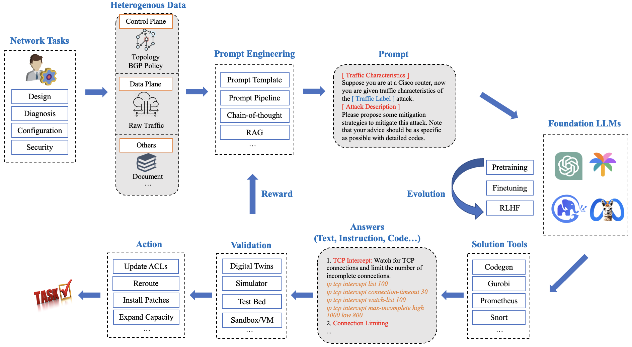
LLM-in-the-loop Architecture for Networking

Slide 11
LLM-in-the-loop Architecture for Networking
Challenges
Developing methods to represent heterogeneous network information in a manner comprehensible to LLMs.
Clarifying LLMs' roles in specific tasks to prevent hallucinations and ensure desired outcomes.
Ensuring the correctness and safety of LLM-generated outputs, such as network management commands.
Constructing a blueprint for future LLM-based autonomous network systems, focusing on reliability and efficiency.

